Slide 1
GNQ 2 – Project Presentation
Presenter Names | Haroon | Kiran | Saketh

Slide 2
Project Description
Brief description of the project

Slide 3
Objectives
Identify overall project objectives
Cost objectives
Automobiles Dataset - To predict right price of Car based on Data provided.
Target Variable - Price
Special objectives
IMDb movies Dataset – To predict whether a movie will win at least one Academy Award
Target Variable – Metric that allows closest estimation of the Likelihood from available data

Slide 4
Automobiles Problem
Data Exploration
Data Cleaning and Processing
Model Summary
Future Scope for Improvement

Slide 5
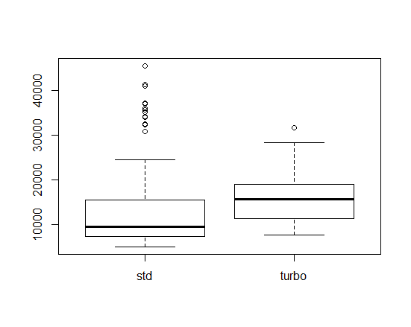
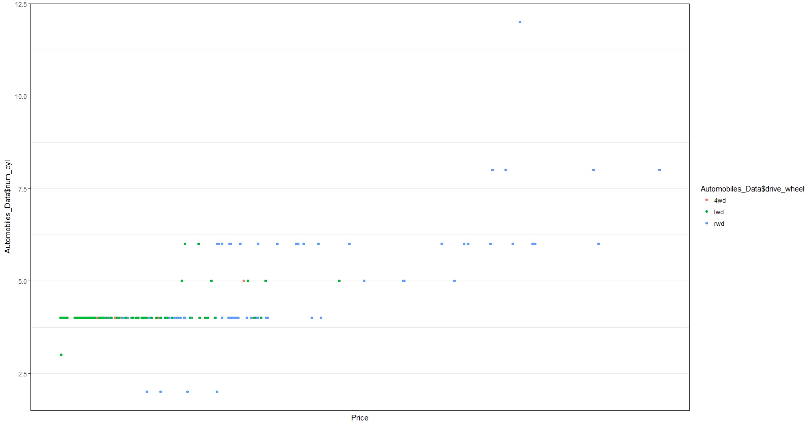
Data Exploration

Slide 6
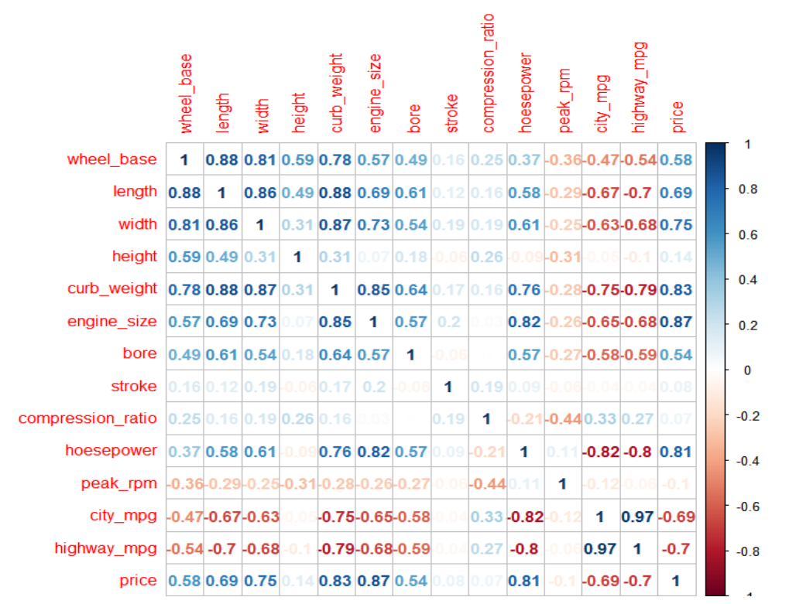
Correlation Matrix

Slide 7
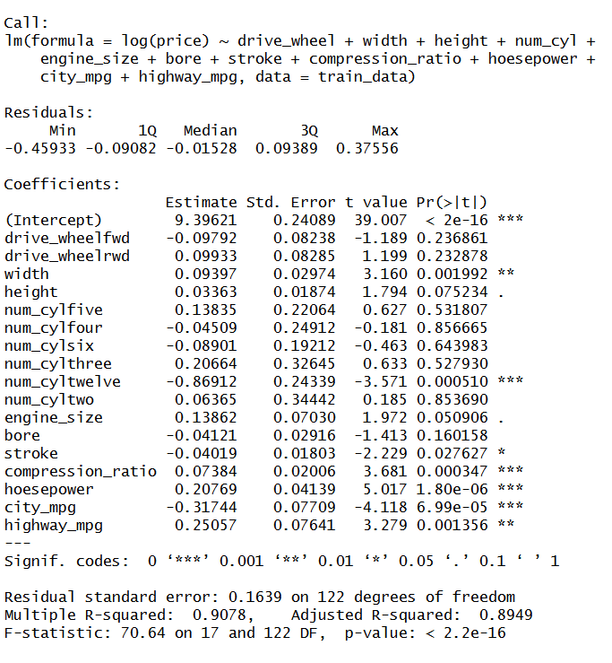

Model Summary

Slide 8
Academy Award Prediction Problem
Data Exploration
Data Cleaning and Processing
AUC Curve
Future Scope for Improvement

Slide 9
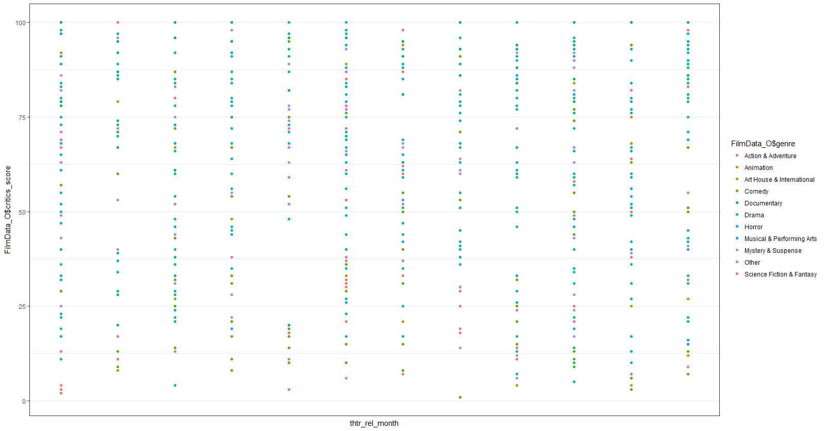
Data Exploration

Slide 10
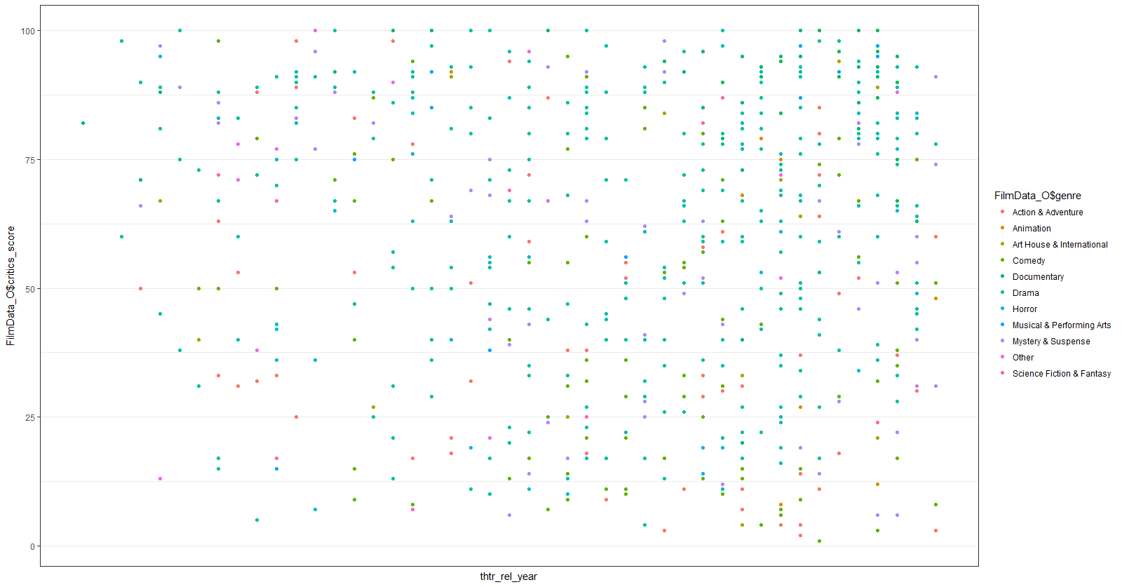

Slide 11
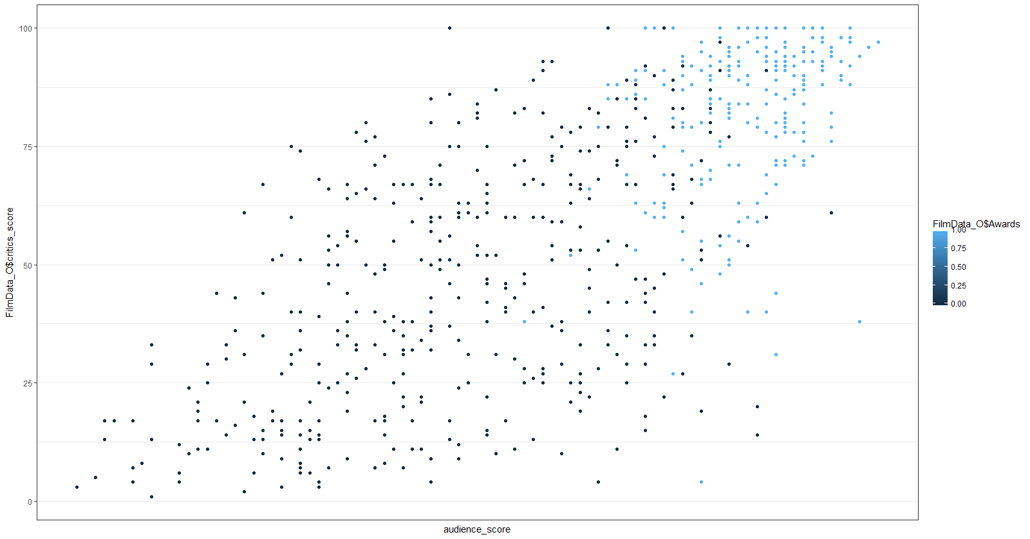

Slide 12
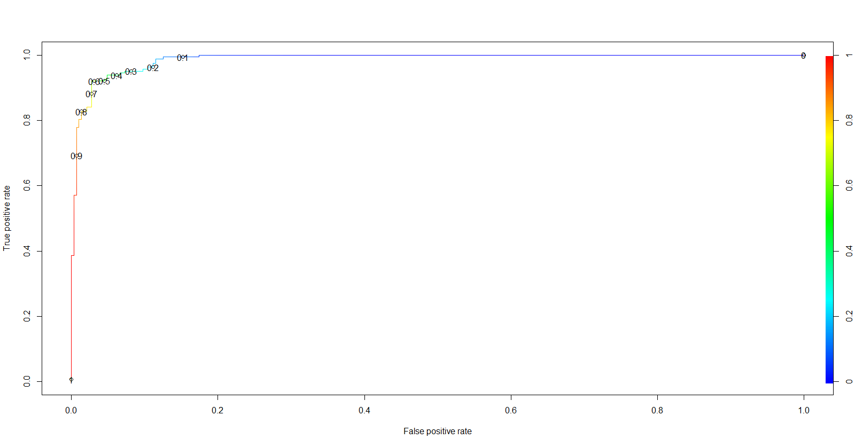
AUC Curve

Slide 13
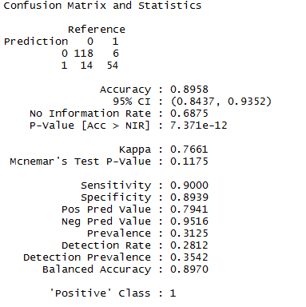
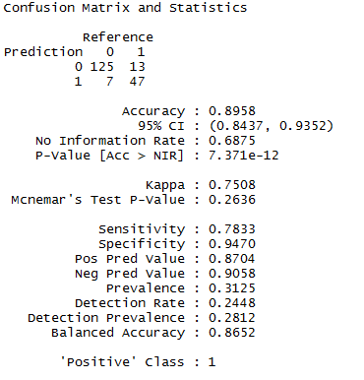
Model Summary
Threshold – 0.2
Threshold – 0.7

Slide 14
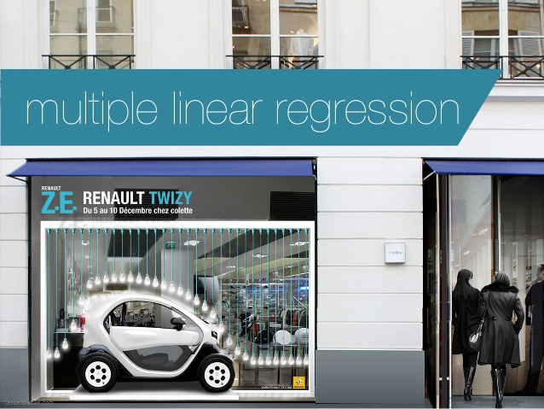

Code Presentation
Saketh Jayam
Automobile – Price Prediction
Linear Regression Model
Kiran
Movies Dataset – Academy Award Winner Prediction
Logistic Regression Model

